Slide 1
Support Vector Machine
Machine learning seminar ch.4

Slide 2
Contents
SVM 심화적 이해
One-Class SVM
Support Vector Regression
SVM 프로그램 실습
2

Slide 3
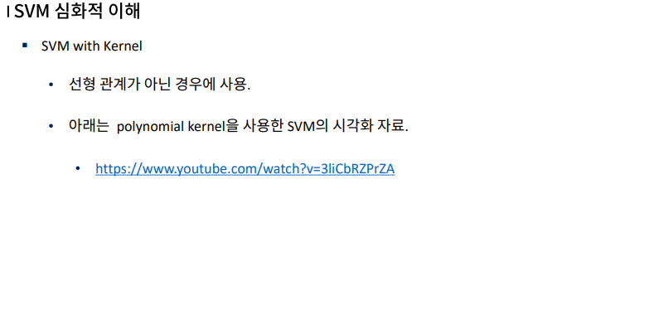
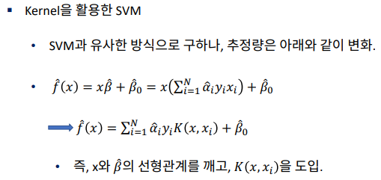
SVM 심화적 이해
3

Slide 4
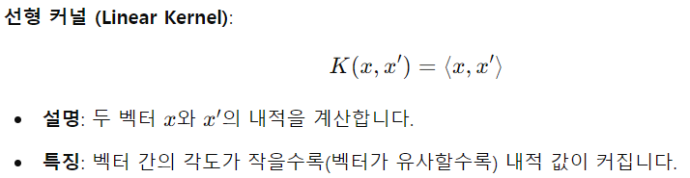
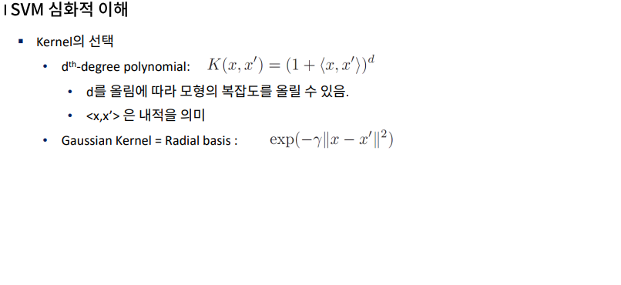
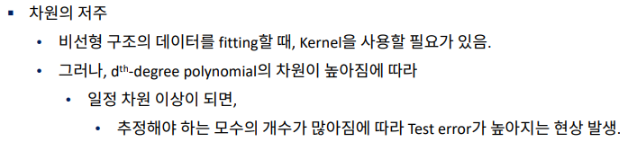
SVM 심화적 이해
4

Slide 5
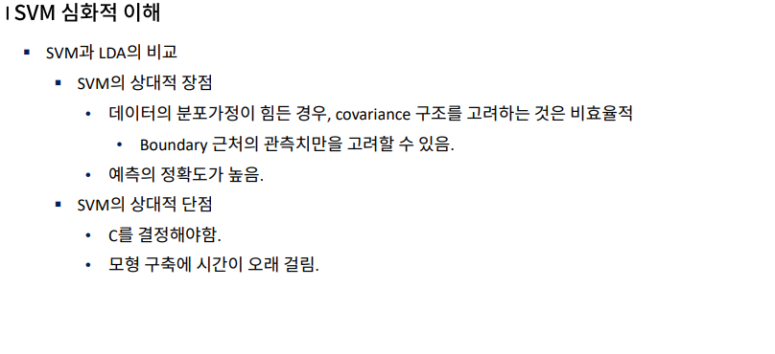
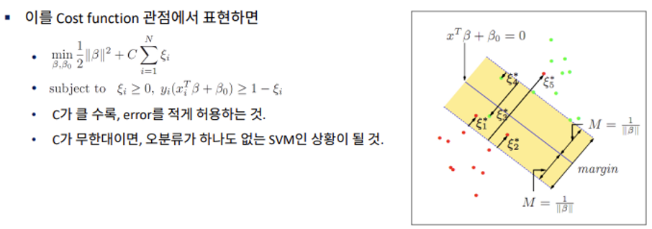
SVM 심화적 이해
5

Slide 6
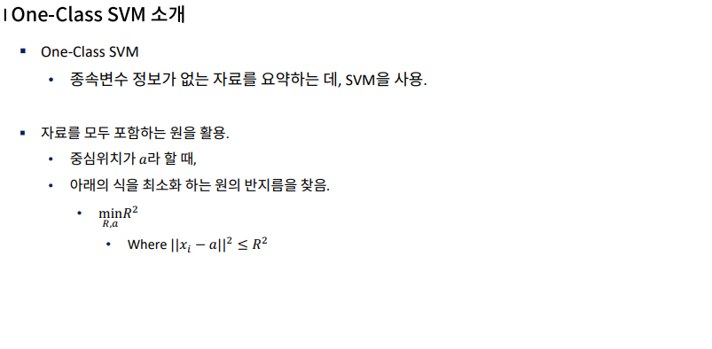
2. One-Class SVM
6

Slide 7
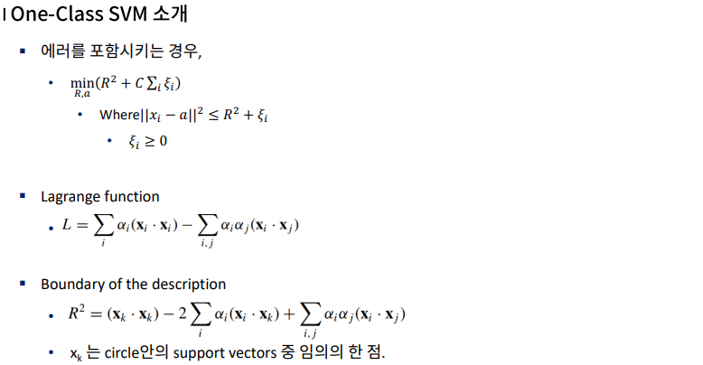
2. One-Class SVM
7

Slide 8
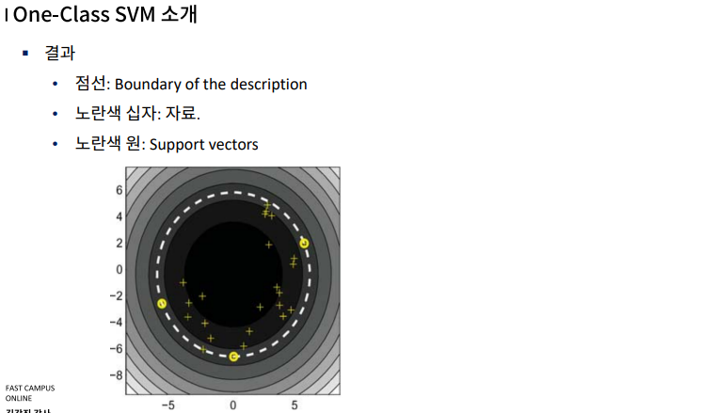
2. One-Class SVM
8

Slide 9
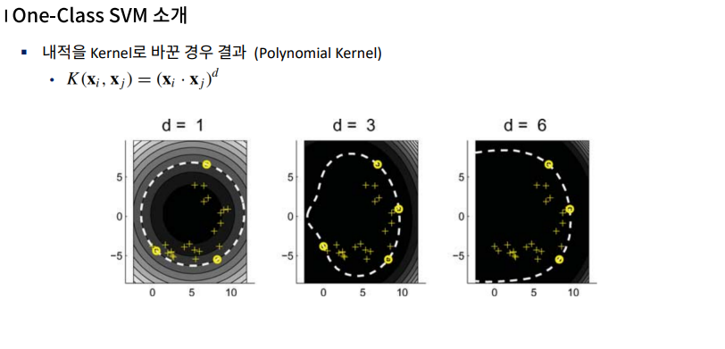
2. One-Class SVM
9

Slide 10
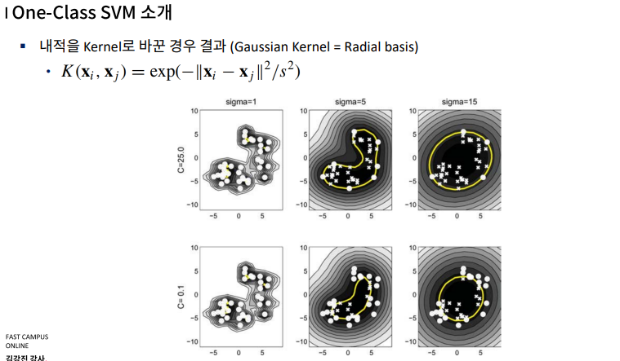
2. One-Class SVM
10

Slide 11
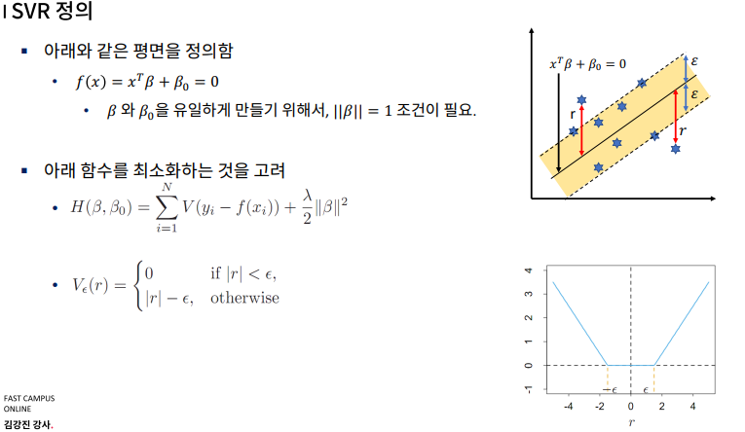
3. Support Vector Regression
11

Slide 12
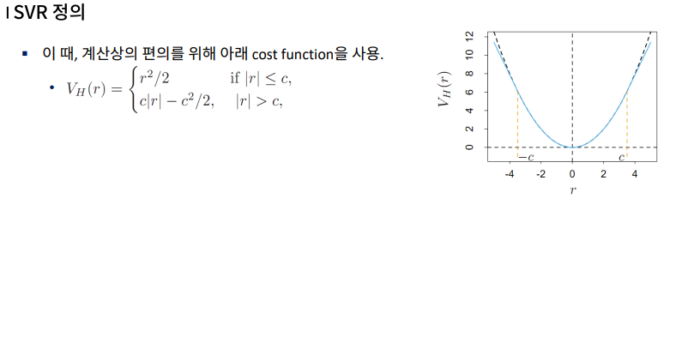
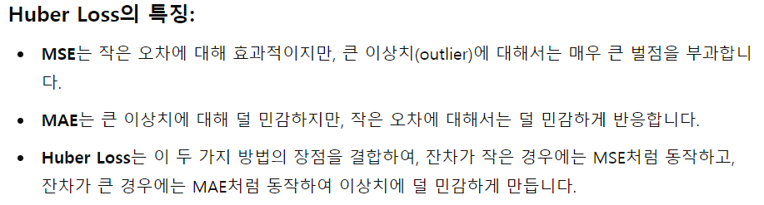
3. Support Vector Regression
12

Slide 13
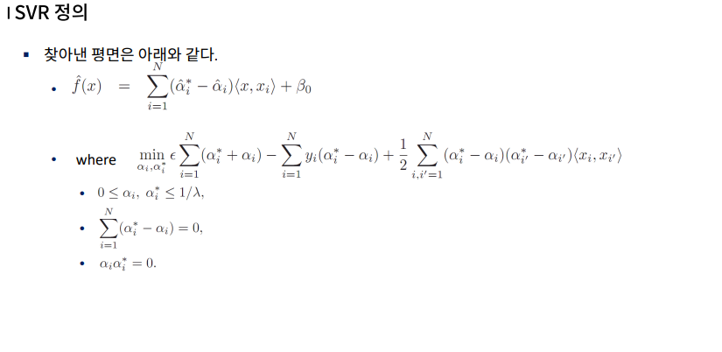
3. Support Vector Regression
13

Slide 14
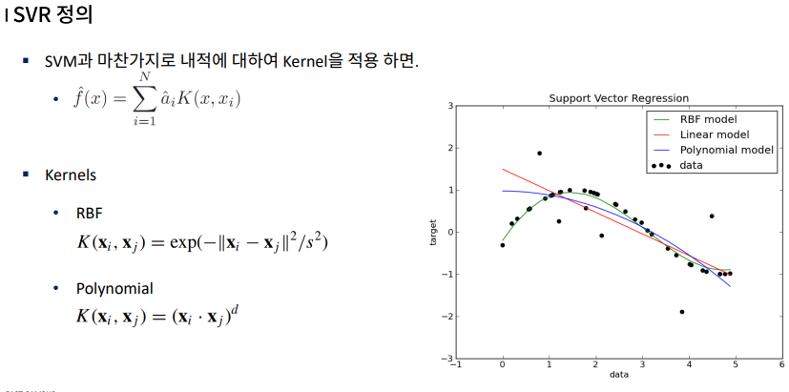
3. Support Vector Regression
14

Slide 15
4. SVM 프로그램 실습
https://colab.research.google.com/drive/1iwZImOByXU-SB1rs2d3DEGQq1uZVtvtH?authuser=0#scrollTo=PTwp6tqCSR7n
15

Slide 16
감사합니다.

